Slide 1
CODEX A GERMAN BEVERAGE COMPANY

Slide 2
ABOUT CODEX PROJECT
CODEX is a German beverage company that is aiming to make the mark in the throughout the Indian market.
A few months ago, they launched their energy drink in 10 cities in India.
Their Marketing team is responsible for increasing brand awareness, market share, and product development.
They conducted a survey in those 10 cities and received results from 10k respondents.
As a Data Analyst, I need to convert these survey results to meaningful insights ,which market team can take the quick drive decisions and actions.

Slide 3
Analysis Categories and tools used
1.Demographic Analysis 2. Consumer Preferences Analysis
3.Competition analysis 4.Marketing Channel Analysis
5.Brand Awareness Analysis 6.Brand Penetration Analysis
7.Purchase behaviour Analysis 8.Product Development Analysis. Tools : Power BI , MySQL For Testing, PPT .

Slide 4
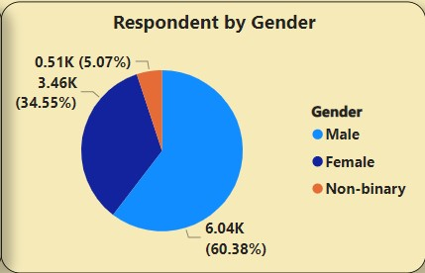
Demographic Insights Analysis
Q. Who prefers energy drink more? (male/female/non-binary?) Out of 10k Respondents 60%(6038) Male preferred drinks and 34%(3455) Female Preferred drinks and rest 5%(507) Non Binary people preferred drinks

Slide 5
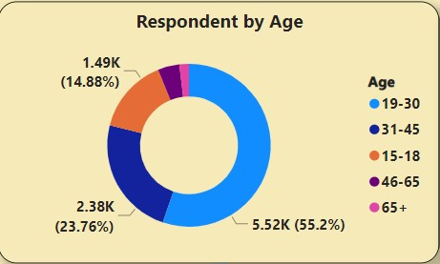
Demographic Insights Analysis
Q .Which age group prefers energy drink more ?
19-30 Age people prefers drinks more, so company more focus on youth living cities

Slide 6
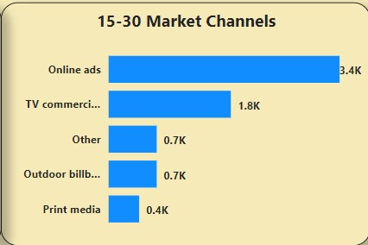
Demographic Insights Analysis
Q .Which type of marketing reaches the most youth (15-30) ? Youth(15-30) people reaches most on Online ads, so company need to focus on Online ads like YouTube ads, web ads, Movie Platform Ads etc.

Slide 7
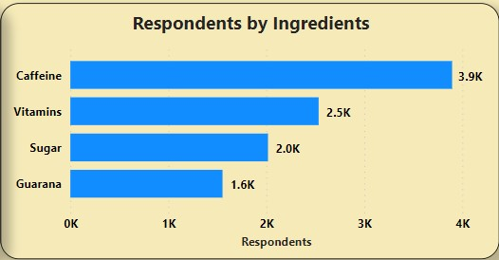
Consumer Preferences Analysis
Q. What are the preferred ingredients of energy drinks among respondents?
Most of the youth prefers drinks along with ingredients caffeine and Vitamins .so caffeine reduce the stress and Vitamins gives energy.

Slide 8
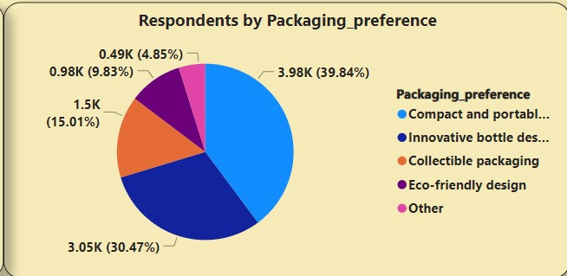
Consumer Preferences Analysis
Q.What packaging preferences do respondents have for energy drinks?
Respondents are most of them are youth so their preference on packaging is compact and portable cans ,because comfortably carry and looks style.

Slide 9
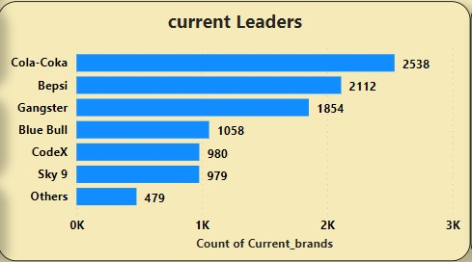
Competition analysis
Q. Who are the current market leaders?
Currently market leader are cola-coka and Bepsi because they having word of mouth in the market, so codex also more focus on word of mouth

Slide 10
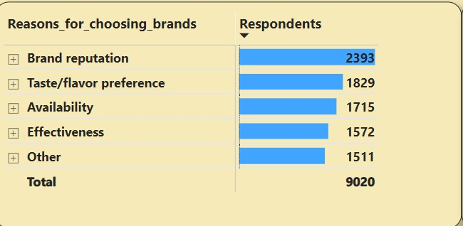
Competition analysis
Q. What are the primary reasons consumers prefer those brands over ours?
Respondents are choosing other then codex based on their Brand Reputation and taste/flavour because other brands maintaining word of mouth we need to focus on that.

Slide 11
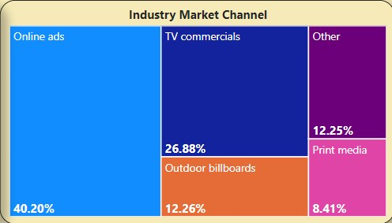
Marketing Channel Analysis
Q. Which marketing channel can be used to reach more customers?
Most of the youth only prefers drinks, so they attracted by seeing online ads and TV commercials, as respondents given feedback online ads are best one .

Slide 12
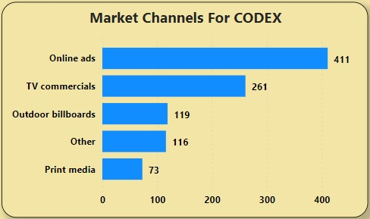
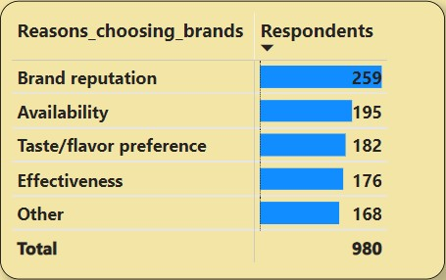
Brand Awareness Analysis
Q. How effective are different marketing strategies and channels in reaching our customers?
Codex also using effective marketing channel as online ads and TV commercials, so that is equals to other competitors brands , and also prefer by Availability of stock .

Slide 13
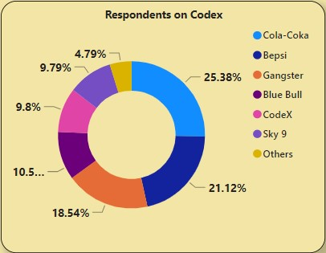
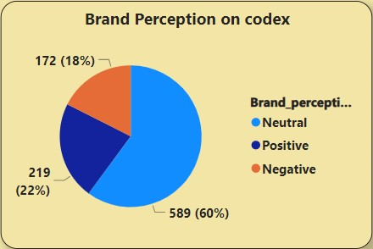
Brand Penetration Analysis
What do people think about our brand?
In the market we are in 5th place even in tier 1 and tier 2 cites , so most of respondents opinion on codex having neutral, so by increasing market channel and their desires will make it to top.

Slide 14
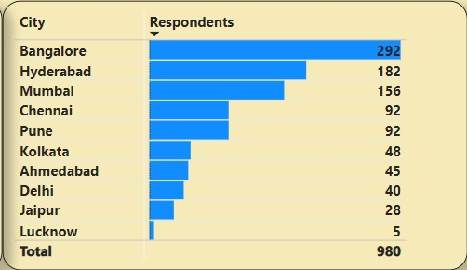
Brand Penetration Analysis
Q. Which cities do we need to focus more on?
We are good in tier 1 cities we need to more focus on tier 2 cities, so that too in north side . Tier 1 - Bangalore , Chennai , Mumbai ,Delhi, Hyderabad . Tier 2 - Kolkata, Ahmedabad ,Pune ,Jaipur , Lucknow.

Slide 15
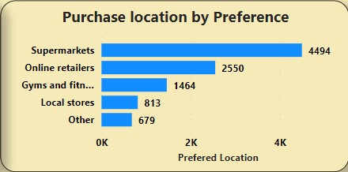
Purchase behaviour Analysis
Q. Where do respondents prefer to purchase energy drinks?
Respondents prefer to purchase drinks in supermarkets among other platforms, so maintaining stocks in supermarkets is other way to increase brand value.

Slide 16
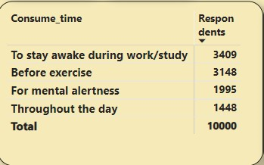
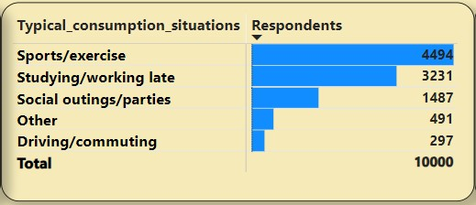
Purchase behaviour Analysis
Q. What are the typical consumption situations for energy drinks among respondents?
Most of the youth 15-30 age people only prefers the drink ,so they in the stage of study ,work and sport/exercise, so most target is youth.

Slide 17
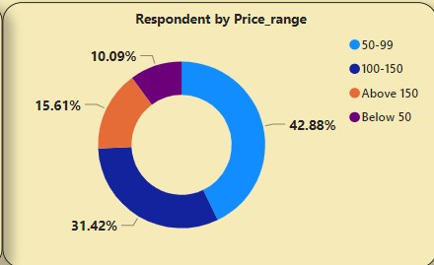
Purchase behaviour Analysis
Q. What factors influence respondents' purchase decisions, such as price range and limited edition packaging?
Our major products purchasing by youth so affordable price is 50-120.and youth prefers packaging in portable cans

Slide 18
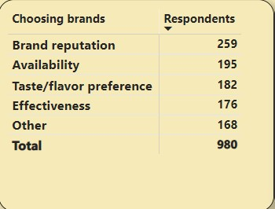
Product Development Analysis
Q. Which area of business should we focus more on our product development? (Branding/taste/availability)
Business need to focus on brand reputation ,stock availability and taste.

Slide 19
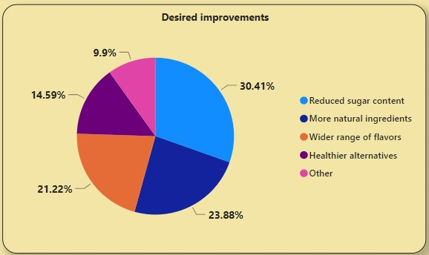
Recommendation
Q. What immediate improvements can we bring to the product?
Most of the respondents are neutral on our product if we change ingredient according to people desires like 30% people desired reduce sugar content .

Slide 20
Recommendation
Q. What should be the ideal price of our product?
Our consumers major youth range of 15-30 age so they can’t afford more price so as per respondent given feedback price range should be in 50-120 is better ,to go top in the market as well attract the youth. Q. What kind of marketing campaigns, offers, and discounts we can run? As per analysis I get know that most of them are prefers marketing as online ads and TV commercials, instead of giving offers and discount reduce the price some of the days and make it online ads will increase our brand reputation.

Slide 21
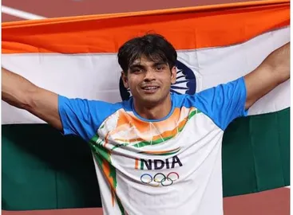
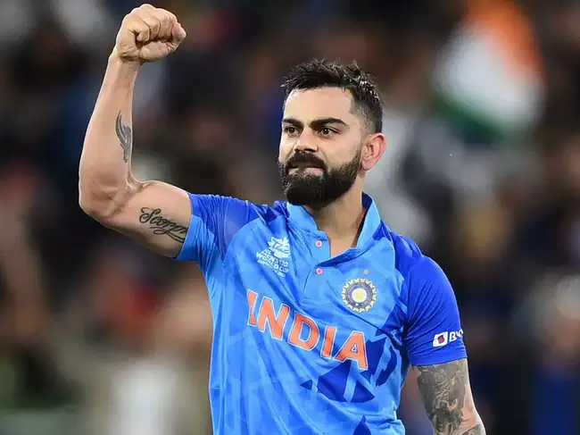
Recommendation
Q. Who can be a brand ambassador, and why?
Athletics and Sports person has the best one for brand ambassador . Neeraj Chopra and Virat Kohli
DRINK CODEX RUN LIKE AN ATHLETICS

Slide 22
Recommendation
Q. Who should be our target audience, and why?
Our target audience major youth because our analysis only given the result most of the age group 15-30 only prefers the drinks for energy and reduce the stress as well as sports and exercise etc..

Slide 23
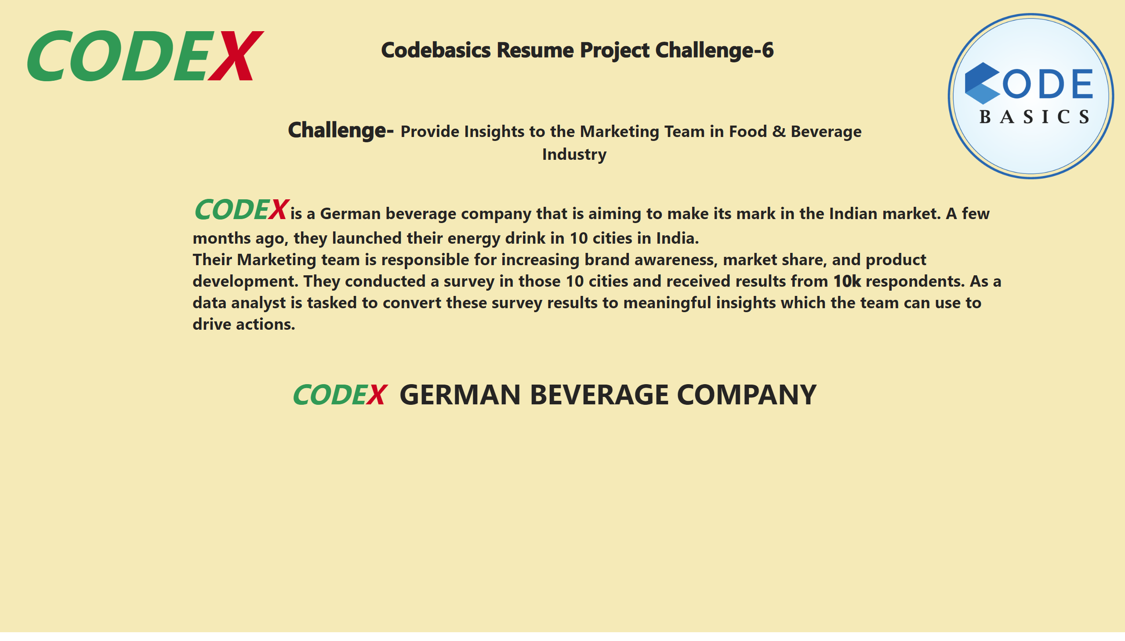
Info
Notes:
textbox
No alt text provided
textbox
No alt text provided
textbox
No alt text provided
textbox
No alt text provided
image
No alt text provided
textbox
No alt text provided

Slide 24
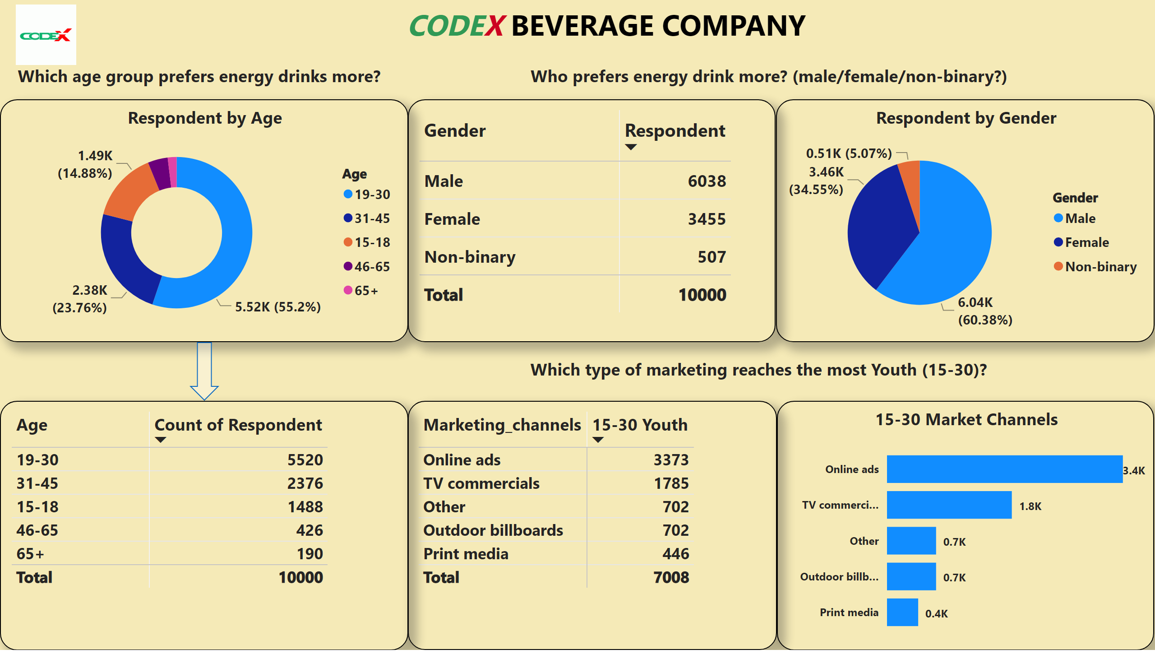
Demographic
Notes:
tableEx
No alt text provided
textbox
No alt text provided
image
No alt text provided
textbox
No alt text provided
pieChart
No alt text provided
textbox
No alt text provided
Respondent by Age
No alt text provided
textbox
No alt text provided
pivotTable
No alt text provided
15-30 Market Channels
No alt text provided
Respondent by Age
No alt text provided
shape
No alt text provided

Slide 25
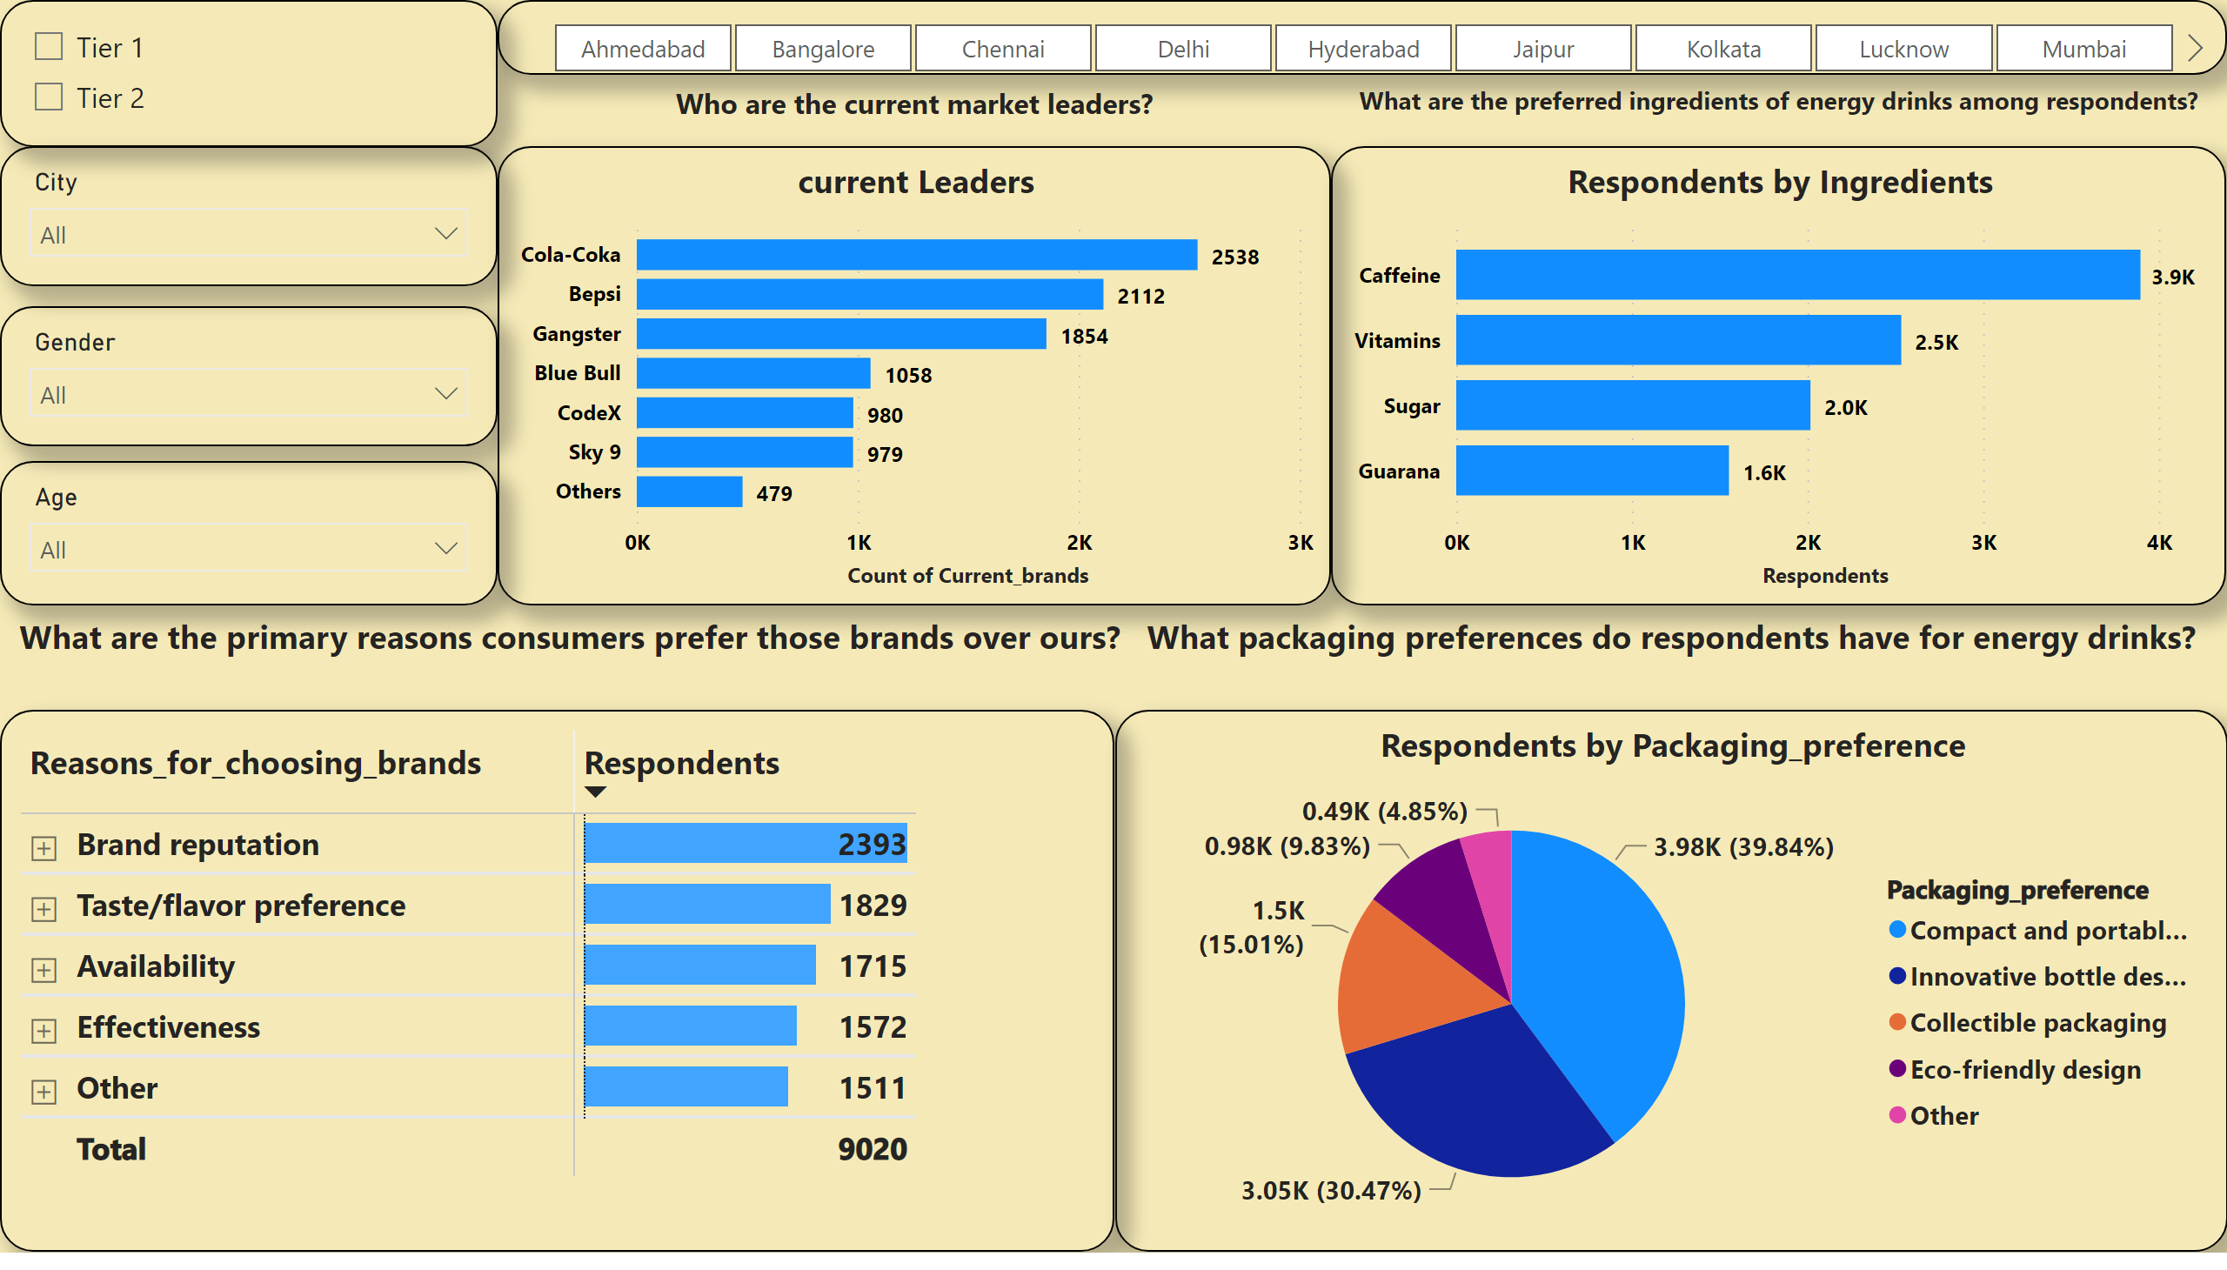
Consumer & Competition
Notes:
textbox
No alt text provided
clusteredBarChart
No alt text provided
textbox
No alt text provided
pieChart
No alt text provided
textbox
No alt text provided
textbox
No alt text provided
current Leaders
No alt text provided
PRIMARY REASONS FOR PREFERE BRANDS OTHER THEN CODEX
No alt text provided
slicer
No alt text provided
slicer
No alt text provided
slicer
No alt text provided
slicer
No alt text provided
slicer
No alt text provided

Slide 26
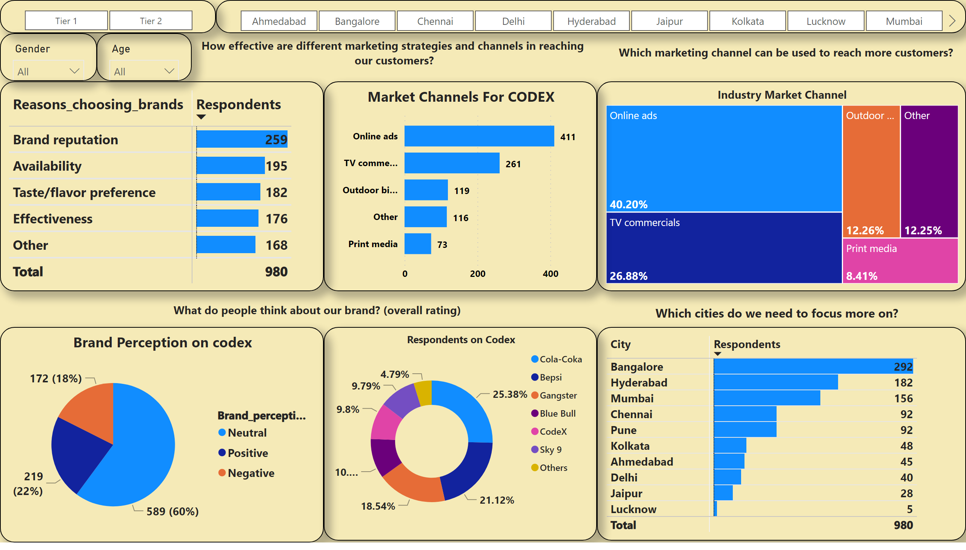
Marketing &Brands
Notes:
Industry Market Channel
No alt text provided
REASONS FOR CODEX CHOOSING
No alt text provided
Market Channels For CODEX
No alt text provided
textbox
No alt text provided
textbox
No alt text provided
slicer
No alt text provided
slicer
No alt text provided
slicer
No alt text provided
slicer
No alt text provided
textbox
No alt text provided
textbox
No alt text provided
tableEx
No alt text provided
Brand Perception on codex
No alt text provided
Respondents on Codex
No alt text provided

Slide 27
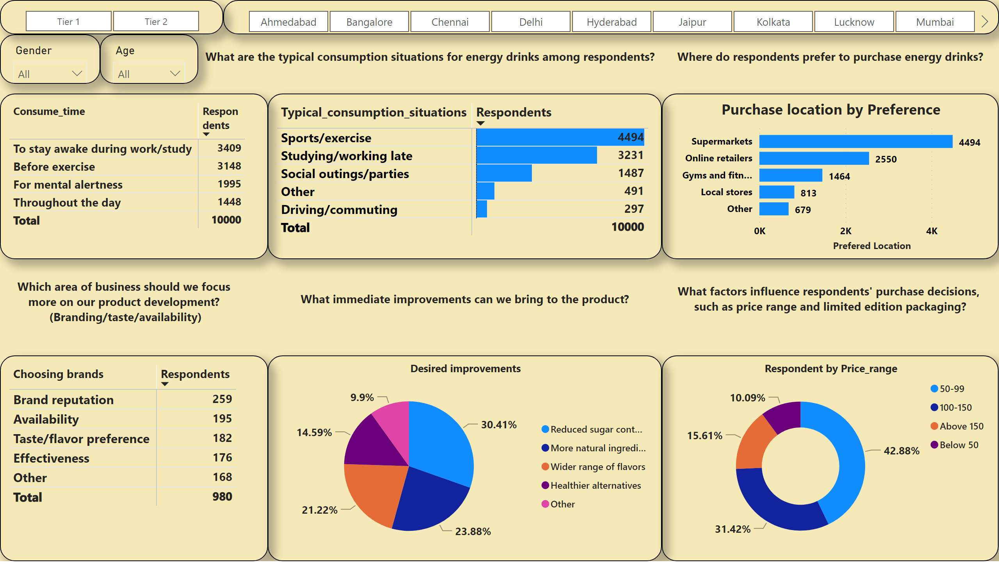
Product & Purchase
Notes:
slicer
No alt text provided
slicer
No alt text provided
slicer
No alt text provided
slicer
No alt text provided
textbox
No alt text provided
textbox
No alt text provided
textbox
No alt text provided
Purchase location by Preference
No alt text provided
pivotTable
No alt text provided
Respondent by Price_range
No alt text provided
textbox
No alt text provided
Desired improvements
No alt text provided
textbox
No alt text provided
pivotTable
No alt text provided
pivotTable
No alt text provided

Slide 28

THANK YOU
Prepared by Devender

